Slide 1



Python Programming
Lecture 23: FastAPI Routers

Slide 2
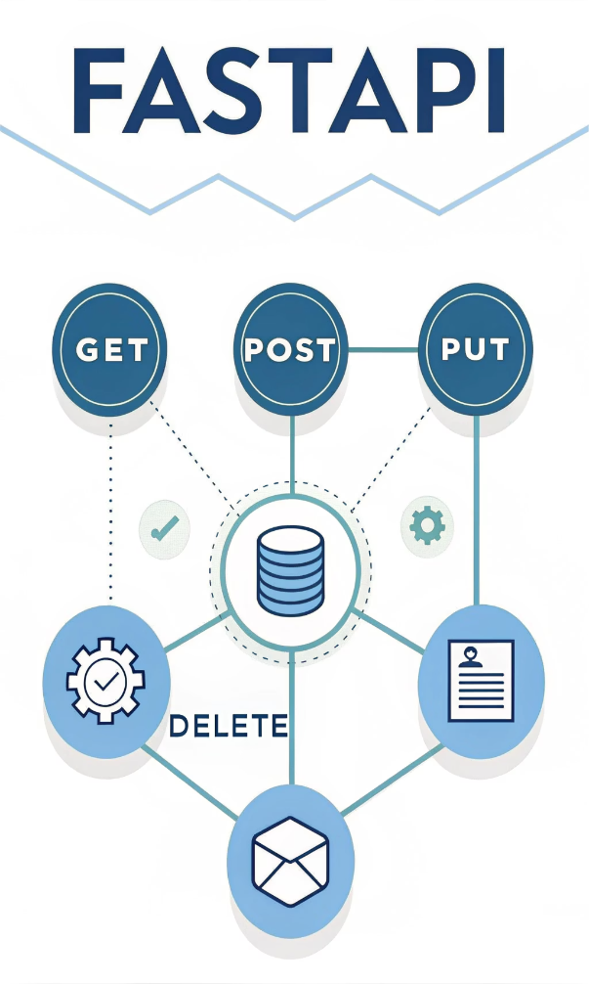
Introduction to FastAPI
Course Objective:
Focus of Today's Lecture:
Understanding FastAPI essentials
HTTP Methods
Preparing for a project on FastAPI
FastAPI Routers
Why It's Important:
These concepts lay the foundation for building organized projects in FastAPI

Slide 3
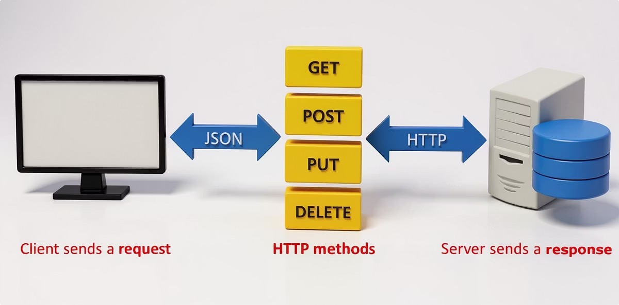
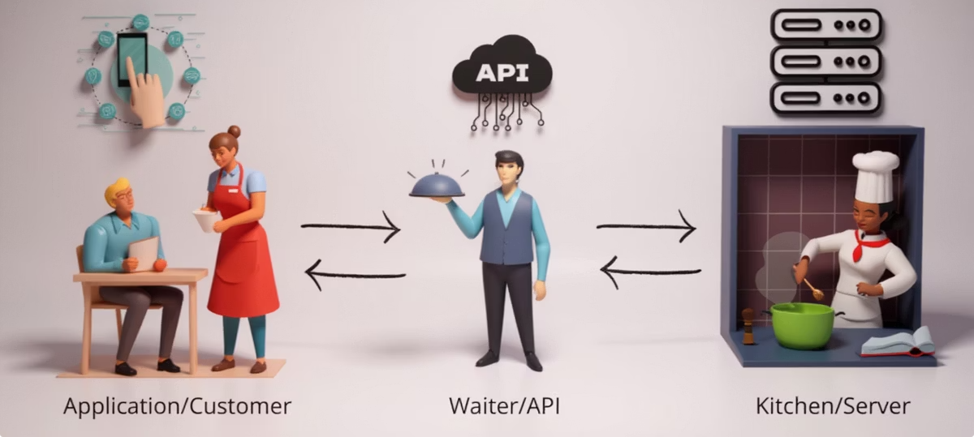
Understanding HTTP Methods
Definition of HTTP Methods:
Different actions for interacting with web resources
Common HTTP Methods:
GET
POST
PUT
DELETE
Why We Need Them:
They define how clients and servers communicate

Slide 4




The GET Method
Purpose of GET:
Retrieve data from the server
Example: Fetching a list of items from a store
Analogy:
Asking a waiter for the menu
FastAPI Usage:
@app.get("/path")

Slide 5




The POST Method
Purpose of POST:
Analogy:
Sending data to the server to create a new resource
Ordering food at a restaurant
Example: Submitting an order or form data
FastAPI Usage:
@app.post("/path")

Slide 6




The PUT Method
Purpose of PUT:
Analogy:
Update an existing resource
Calling the waiter to modify your order
Example: Changing an order after submitting it
FastAPI Usage:
@app.put("/path/{id}")

Slide 7




The DELETE Method
Purpose of DELETE:
Analogy:
Remove a resource from the server
Calling the waiter to cancel your order
FastAPI Usage:
@app.delete("/path/{id}")

Slide 8
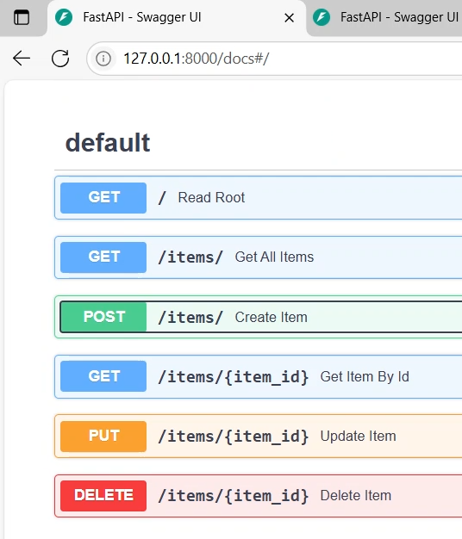
Overview of HTTP Methods in FastAPI
How to Use Them:
@app.get(), @app.post(), @app.put(), @app.delete()
Important Points:
These decorators are used to define routes
Each method corresponds to a specific task (retrieving, creating, updating, deleting data)

Slide 9

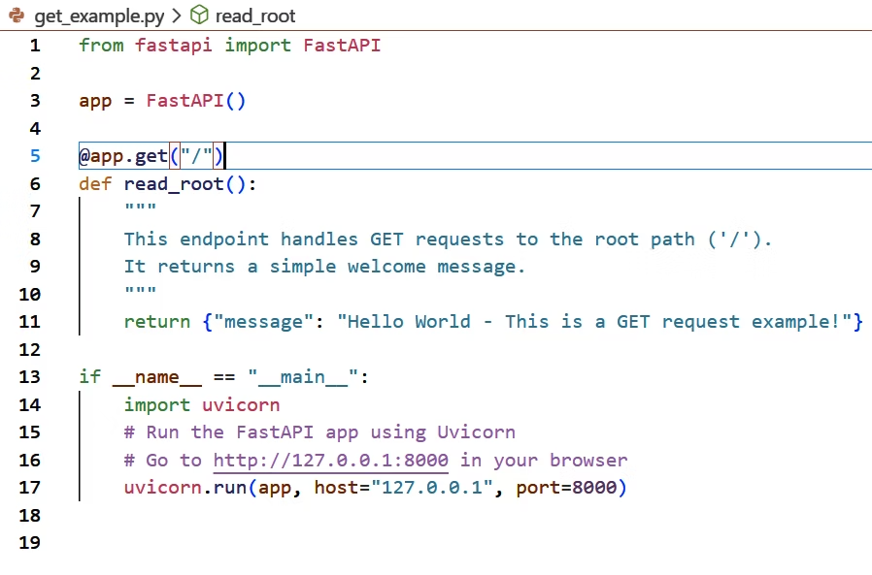
GET Method Example
Code Overview:
Simple home page using GET
FastAPI Example:
@app.get("/")
Returns a simple welcome message
Test It Out:
Visit http://127.0.0.1:8000 in your browser

Slide 10

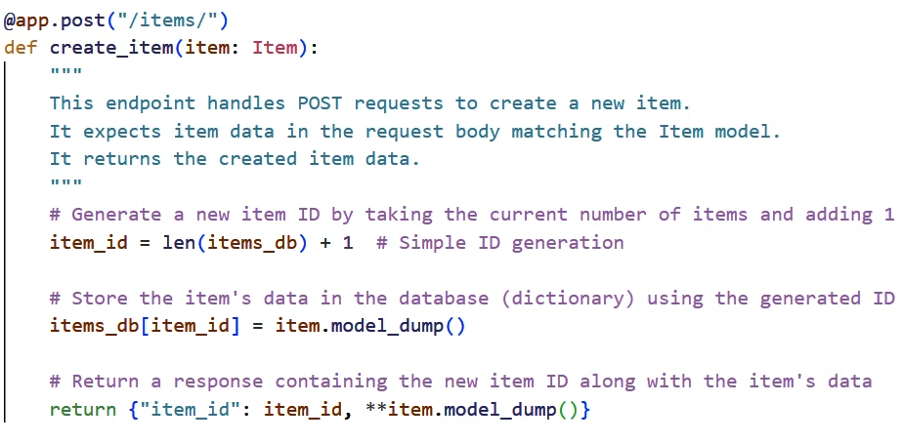
POST Method Example
Code Overview:
Creating a new item using POST
FastAPI Example:
@app.post("/items/")
Sends item data and returns the new ID
Test It Out:
Use API documentation at /docs to test

Slide 11

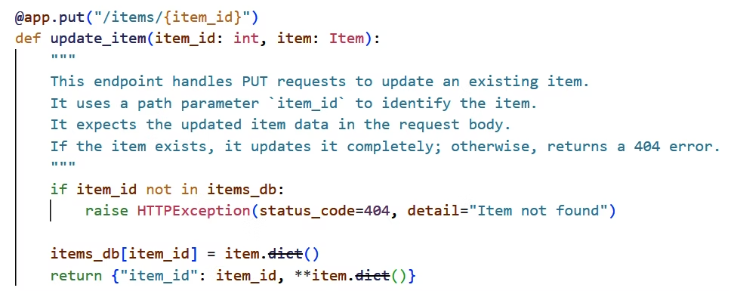
PUT Method Example
Code Overview:
Updating an item using PUT
FastAPI Example:
@app.put("/items/{item_id}")
Updates an item's data
Test It Out:
Use API docs to update an item by ID

Slide 12

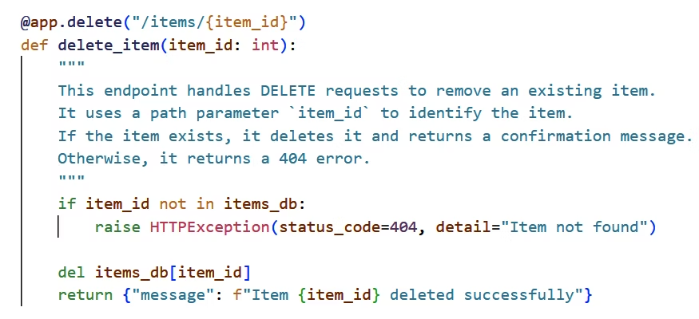
DELETE Method Example
Code Overview:
Deleting an item using DELETE
FastAPI Example:
@app.delete("/items/{item_id}")
Deletes the item based on the item ID
Test It Out:
Use API docs to delete an item

Slide 13


Path Parameters in FastAPI
What Are Path Parameters?
Usage in FastAPI:
Parts of the URL used to pass specific data
Defined using {} in the route
Example: /items/{item_id}
Automatically validated with Python type hints
Path Parameter Example
Code Overview:
FastAPI Example:
Test It Out:
Fetching a specific item by its ID using GET
@app.get("/items/{item_id}")
Try different IDs in your browser
Fetches data for a given item_id

Slide 14

Query Parameters in FastAPI
What Are Query Parameters?
Usage in FastAPI:
Optional parameters added at the end of the URL
Automatically handled as function arguments
Example: /items?skip=0&limit=10
Supports default values
Query Parameter Example
Code Overview:
FastAPI Example:
Test It Out:
Retrieving items with query parameters
@app.get("/items/")
Try different query combinations in your browser
Filters items with skip, limit, and q

Slide 15


Organizing Code with Routers
Why Use Routers?
Benefits of Routers:
Avoid messy, unmanageable code when APIs grow
Maintainable
Group related endpoints into separate files
Easy to scale
Organized structure for large projects

Slide 16

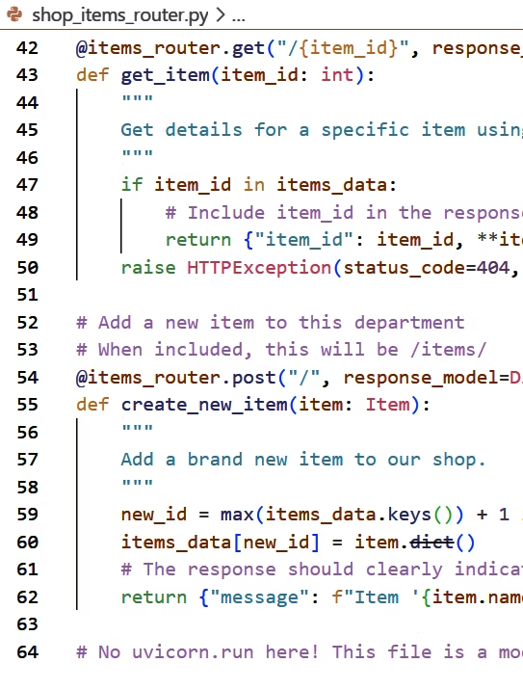
Using FastAPI Routers
How to Define a Router:
Import APIRouter and create an instance
Example: router = APIRouter()
Include Routers in Main App:
Use app.include_router()
Allows modular structure for your app

Slide 17
Router Example (Item Router)
Code Overview:
FastAPI Example:
Integration with Main App:
Creating a router for item operations
@items_router.get("/")
Handles requests for /items/ with item data
app.include_router(items_router, prefix="/items", tags=["Shop Items"])

Slide 18

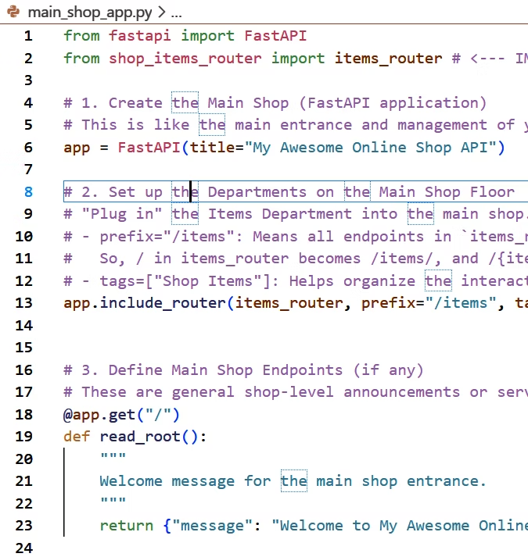

Main App and Router Integration
How Routers Work Together:
Define endpoints in separate files and include them in the main app
Helps organize and manage multiple sections of the app
FastAPI Example:
app.include_router(items_router, prefix="/items")
Access http://127.0.0.1:8000/items/ for item-related operations

Slide 19

Conclusion and Practice
Key Takeaways:
HTTP methods (GET, POST, PUT, DELETE) define the actions in an API
Path and query parameters allow flexible and dynamic data retrieval
Organizing code with routers is essential for large projects
Next Steps:
Practice creating different types of APIs
Experiment with routers and modular organization in FastAPI

